Slide 1

Testing Godot
EN 601.422/622: Software Testing and Debugging Final Project
By: Derek Dang, Elmi Moallin, Jako Banerjee

Slide 2
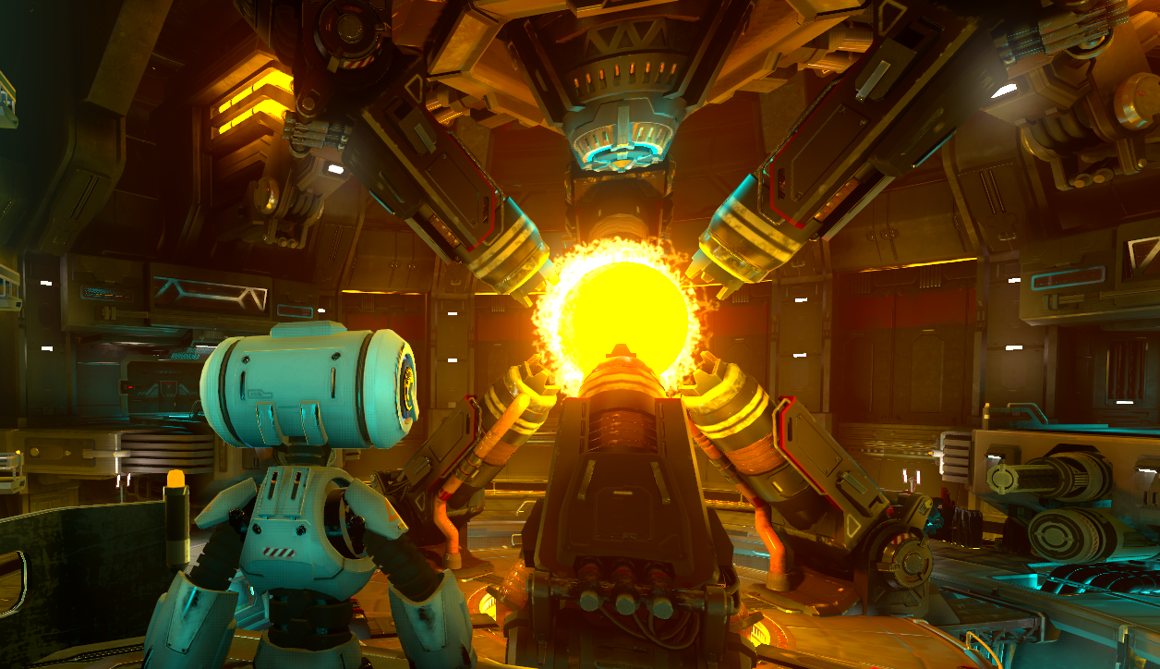

Godot
Open- Source Game Engine
PC/Android/iOS/MacOS/Linux/Web/VR
2D/3D Games
Official releases support GDScript, C++, C#
Multiplayer Support
Community Driven Support

Slide 3
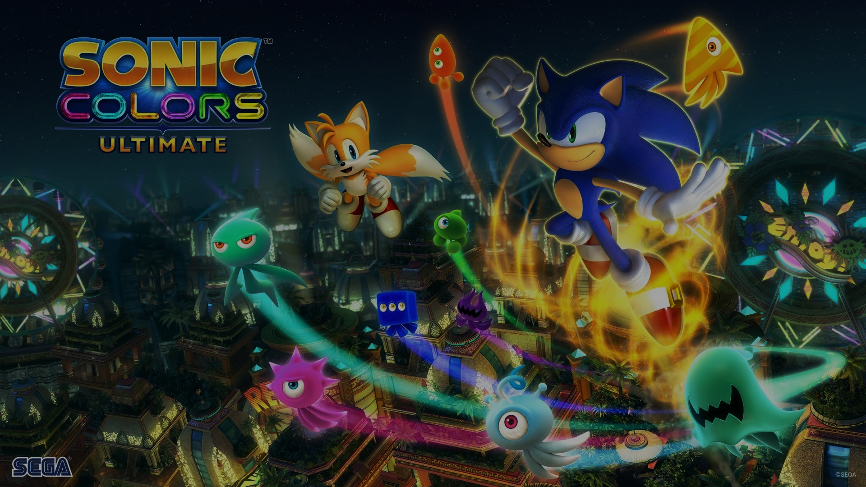
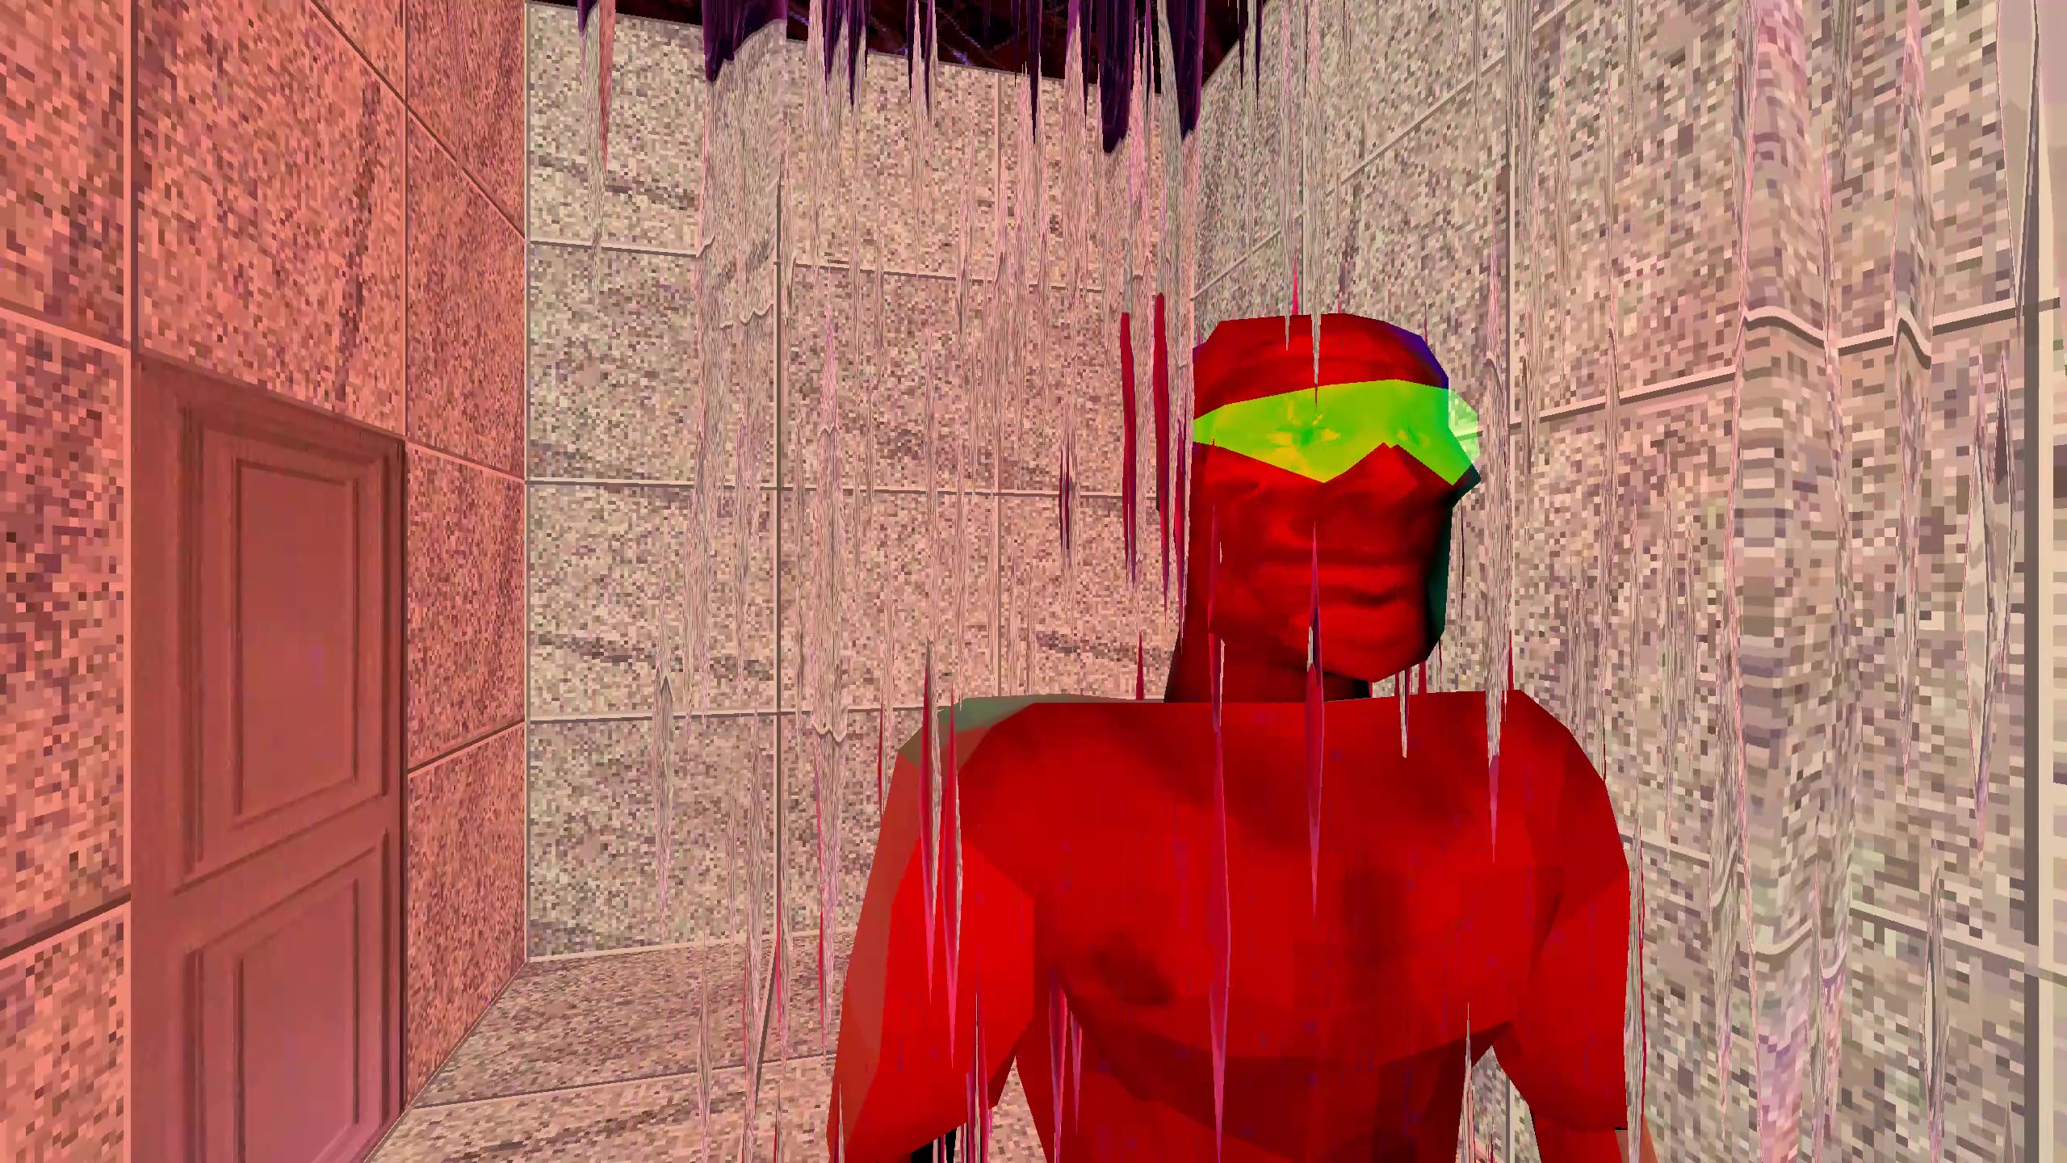


Slide 4
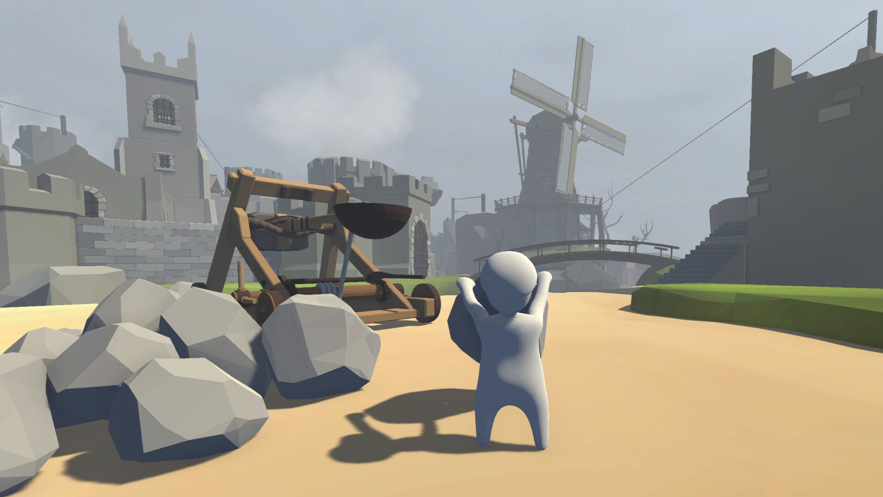
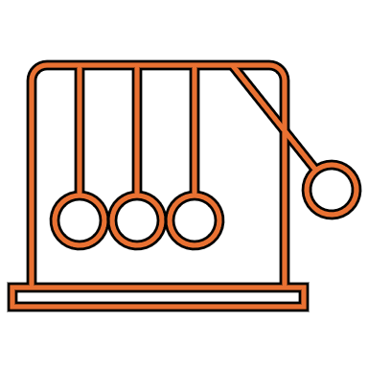



Testing Criterions
Physics
Collision
Detection
Black-box
Testing
White-box
Testing
Stress Testing

Slide 5
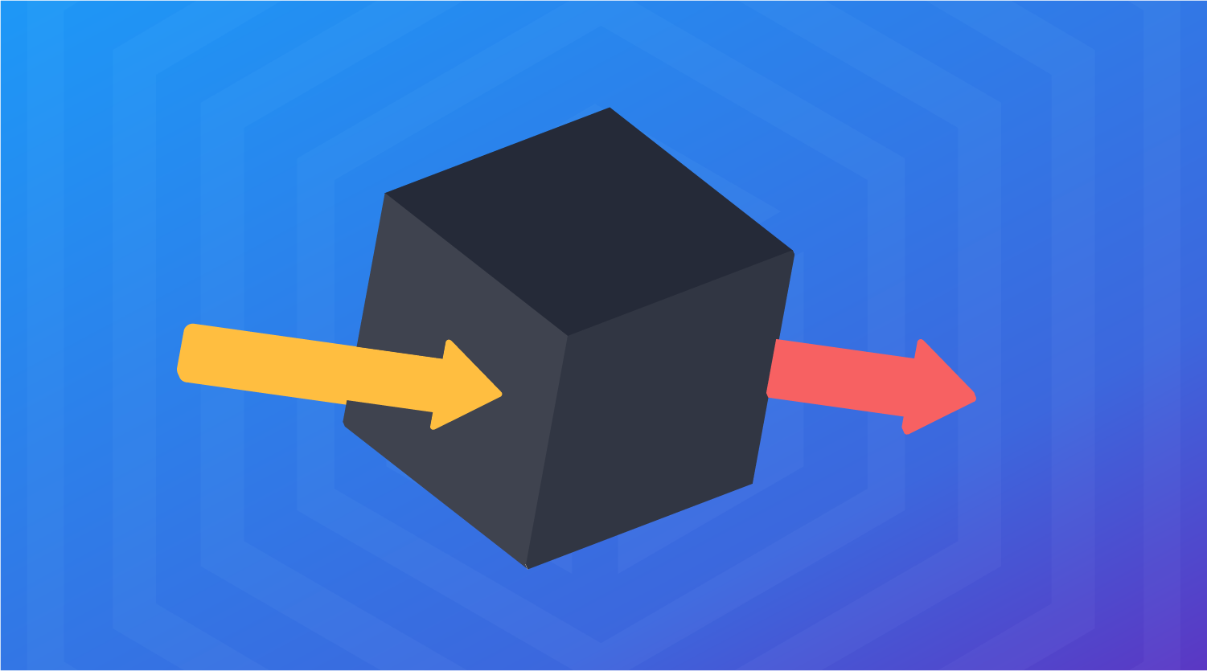
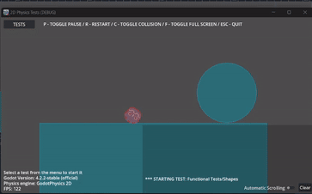
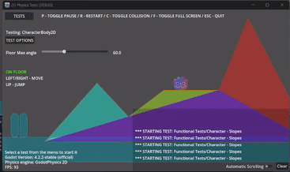
Black-box testing
Equivalence Partitions based on the...
-Shape
-Type of Physics Body
-Center of Mass
-Mass
-Angular and Linear Velocity
-Dampening
-Size
Ran scripts initially for each choice coverage.
When estimating issues, focused on static body versus rigid body.
Conducted pairwise coverage on these specific sections.
Uncovered a significant issue with collision detection.
Discovered an almost quantum tunneling effect, where objects moving at high speeds over (10000 p/s) could break through collision barriers.
Noted the objects were promptly thrown outside those collision barriers in the game engine.

Slide 6
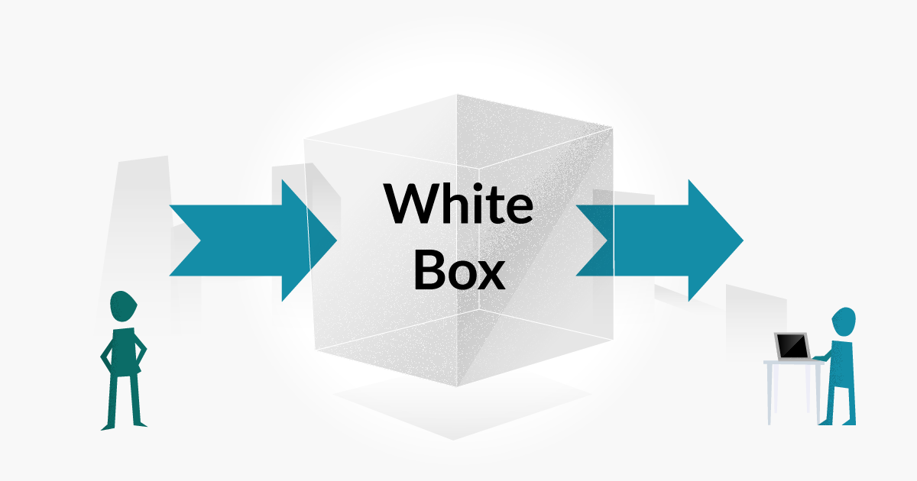

Slide 7
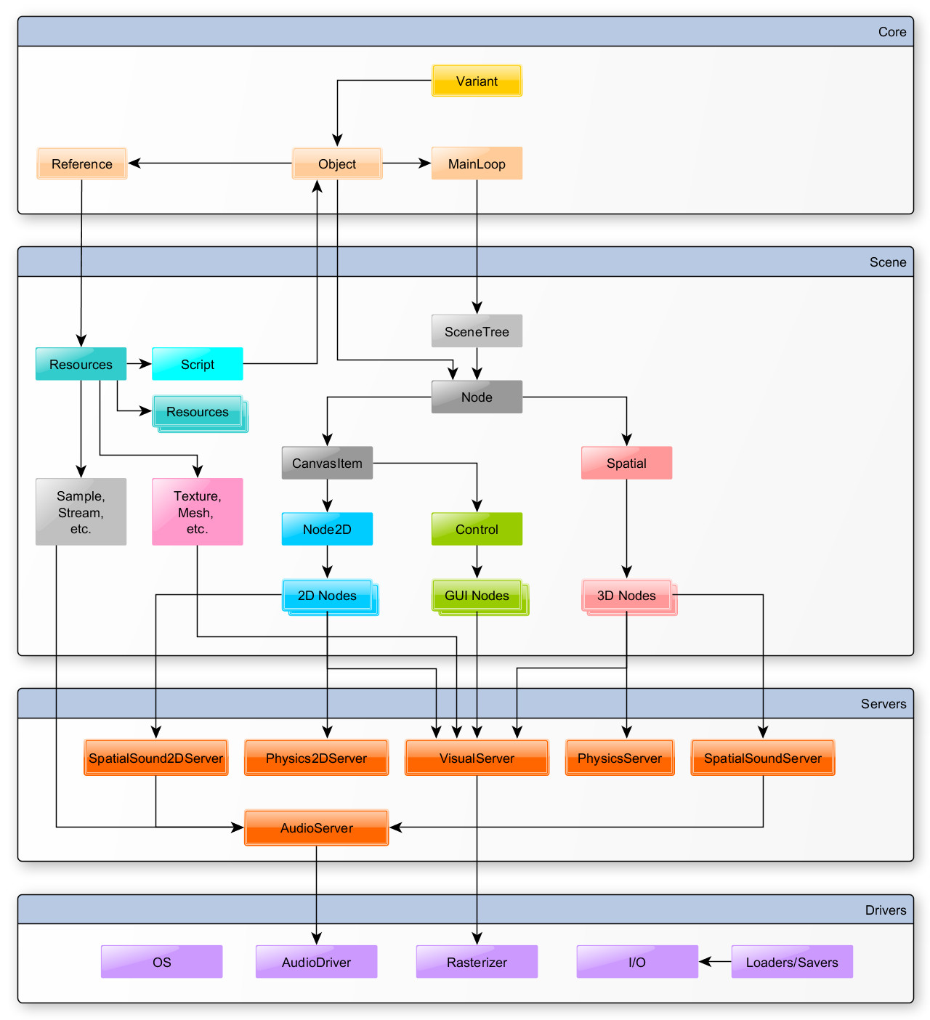
Basic Architecture of Godot
All 2D game objects within a scene has their physics calculated in Physics2DServer
White-box testing mainly focused on low-level physics engine classes

Slide 8
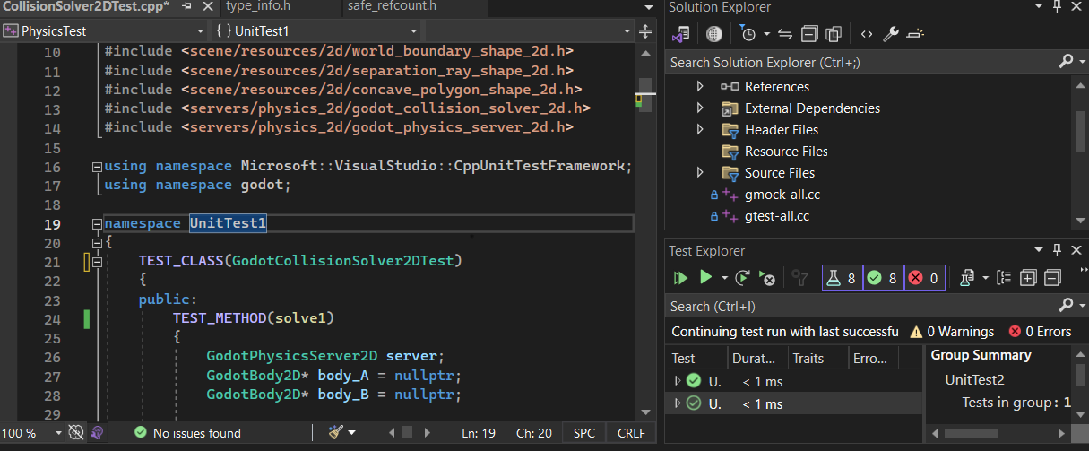
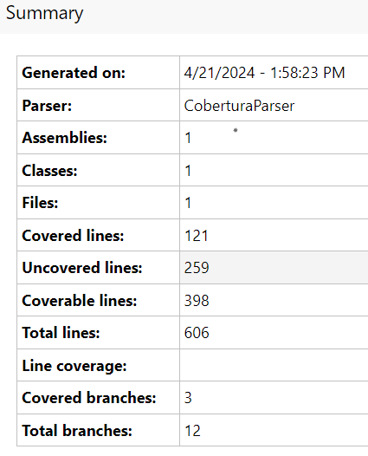

Collision Solver Class, Testing, and Coverage
Godot source code is in C++,
Visual Studios IDE
Microsoft CppUnitTest framework
Issues with white-box testing a physics engine:
Extremely complex
Numerical Instabilities
Coverage Testing Unavailable on VS code:
Third party extensions (Fine Code)

Slide 9
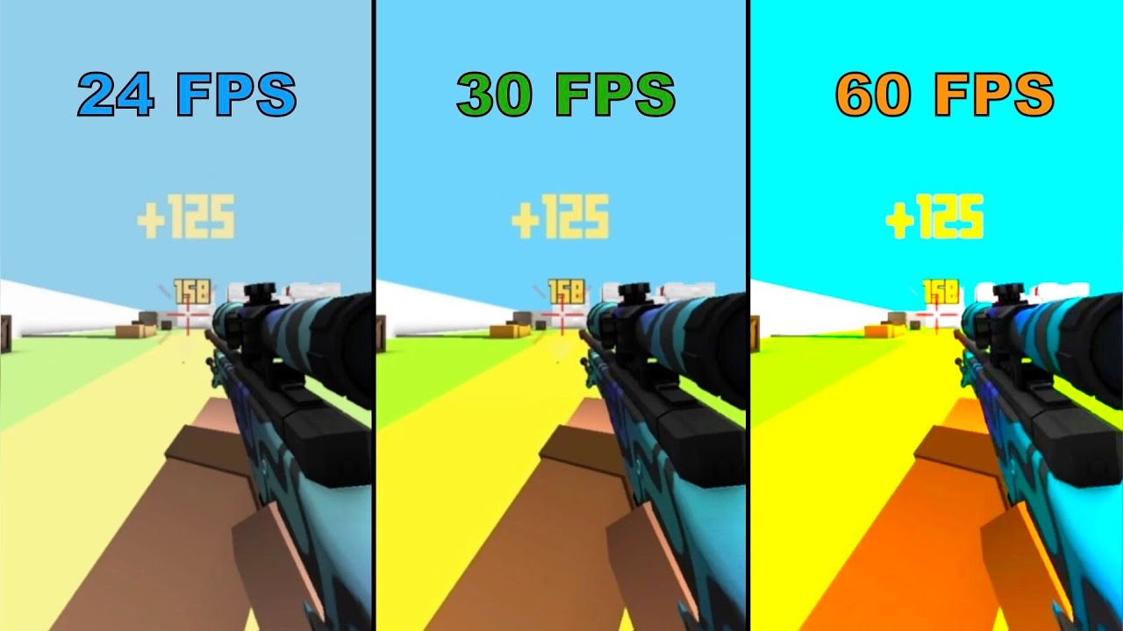
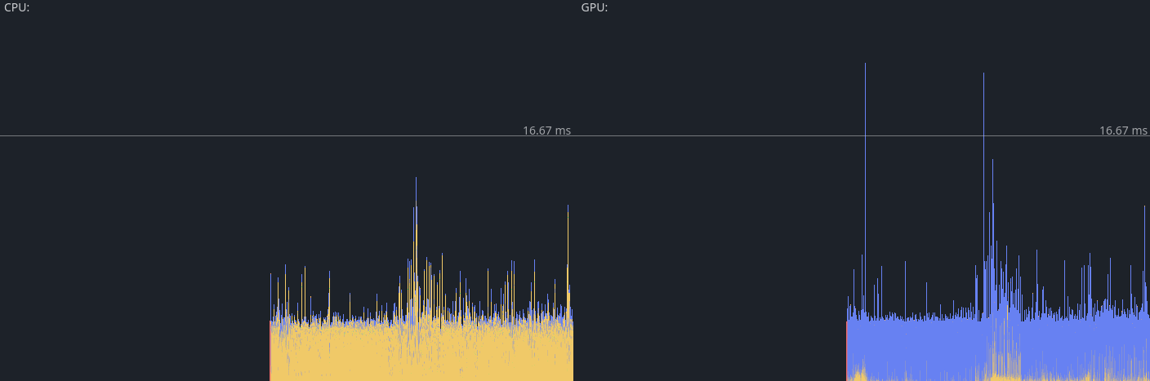
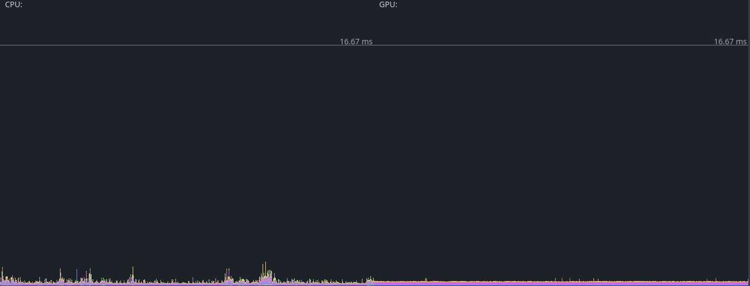
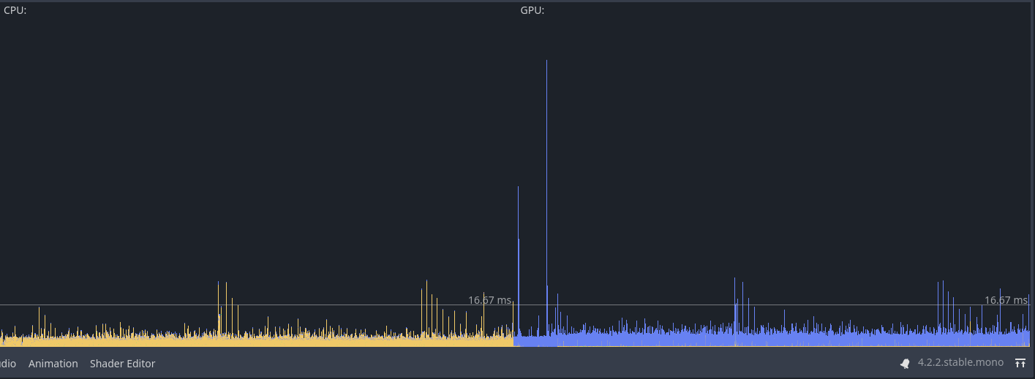
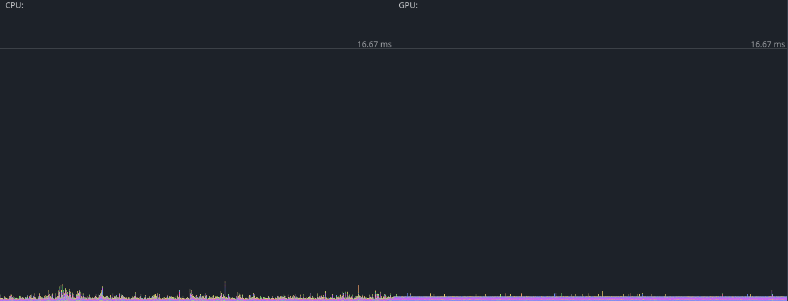
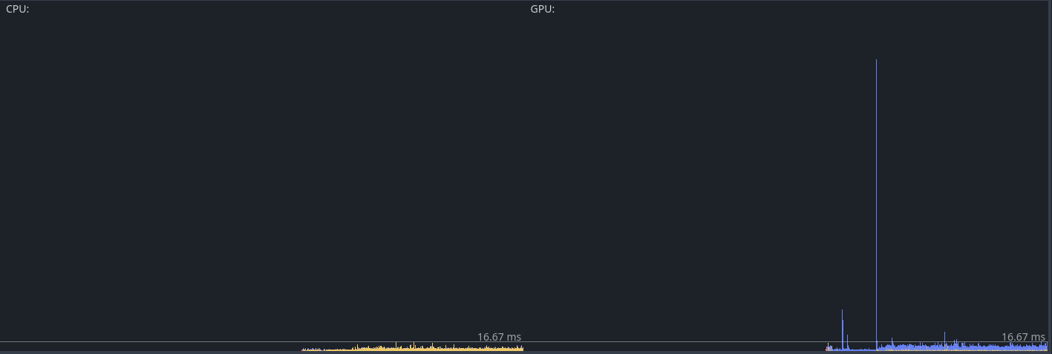
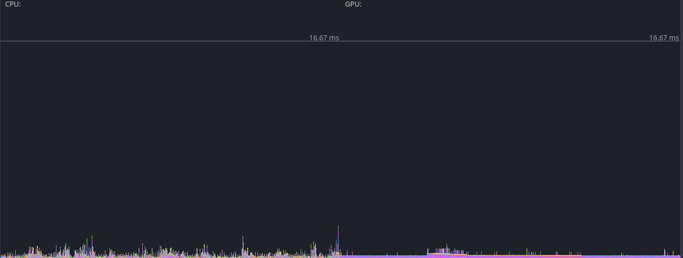
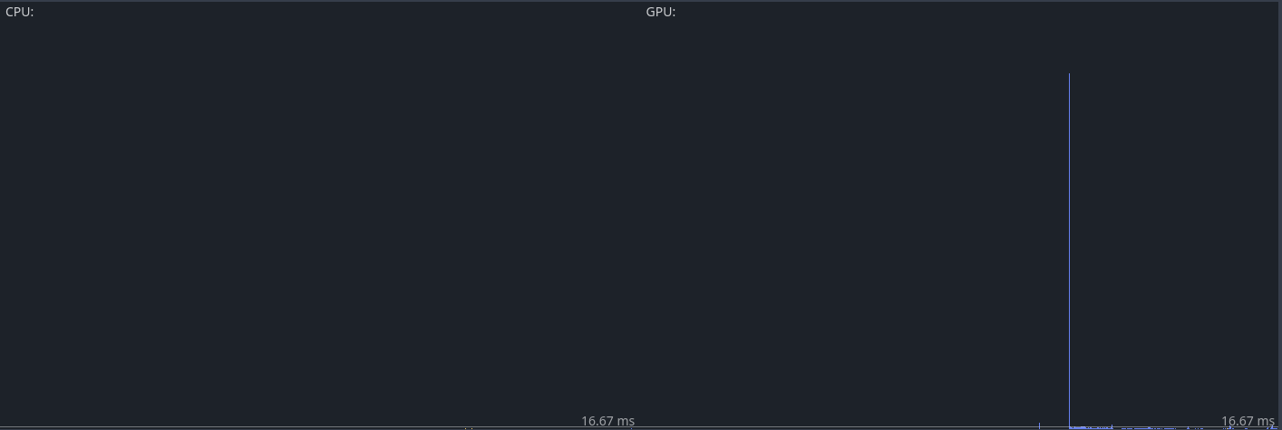
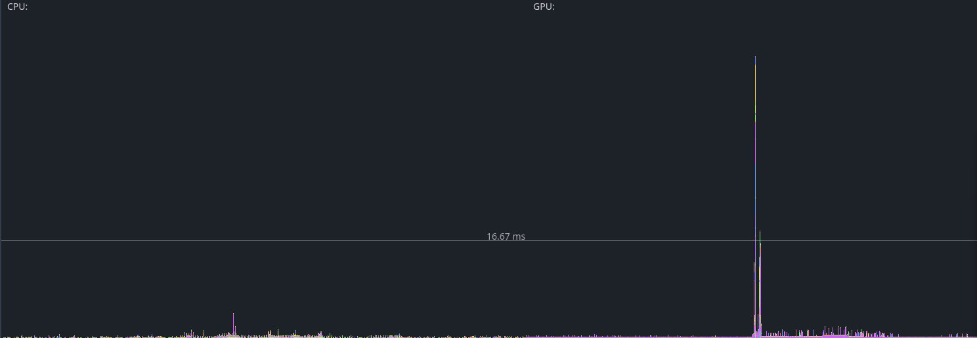
2D
3D
Frame Time
25
200
500
1000

Slide 10
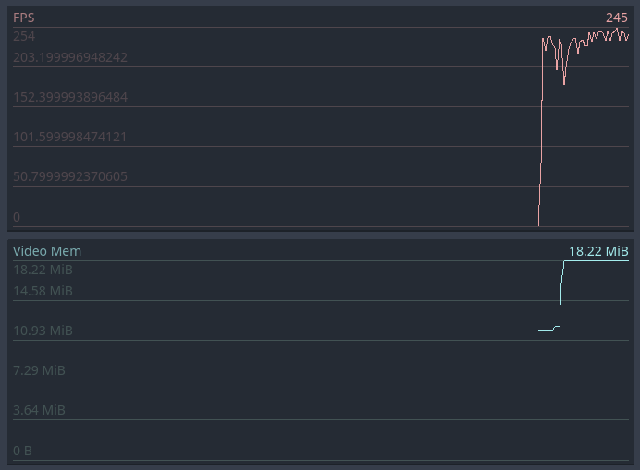
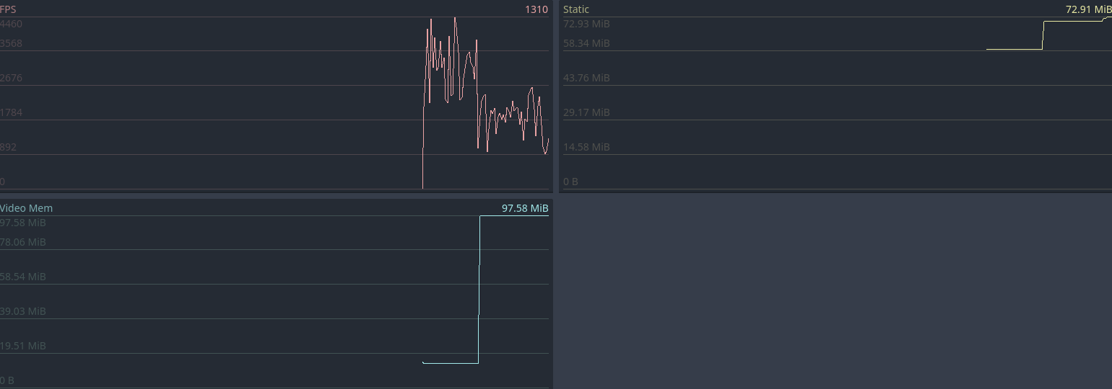
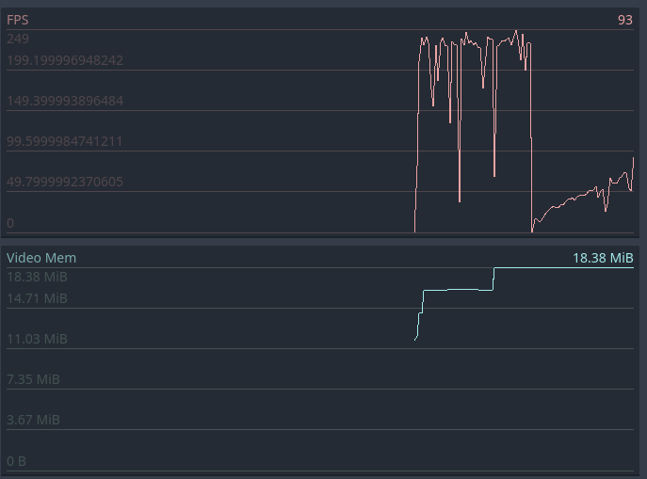
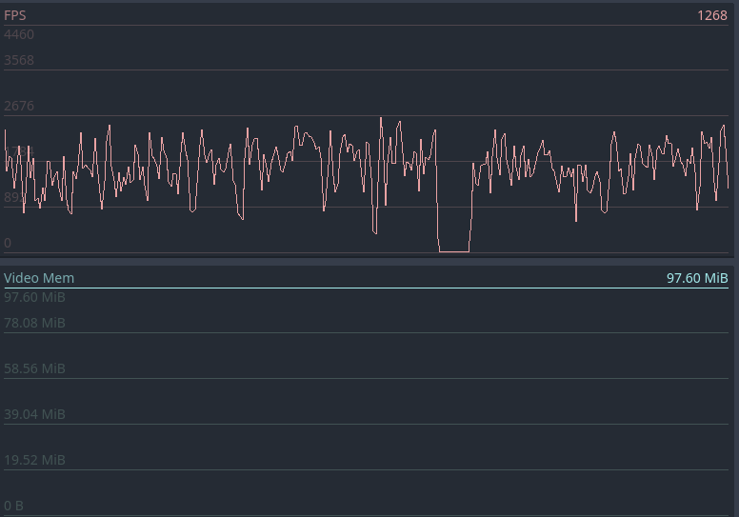
FPS/Vid. Memory
2D
3D
25
1000

Slide 11

Thank You!

